Slide 1
Hospitality Industry 401(k) Plan
As of 12/31/2024
524867-01

Slide 3
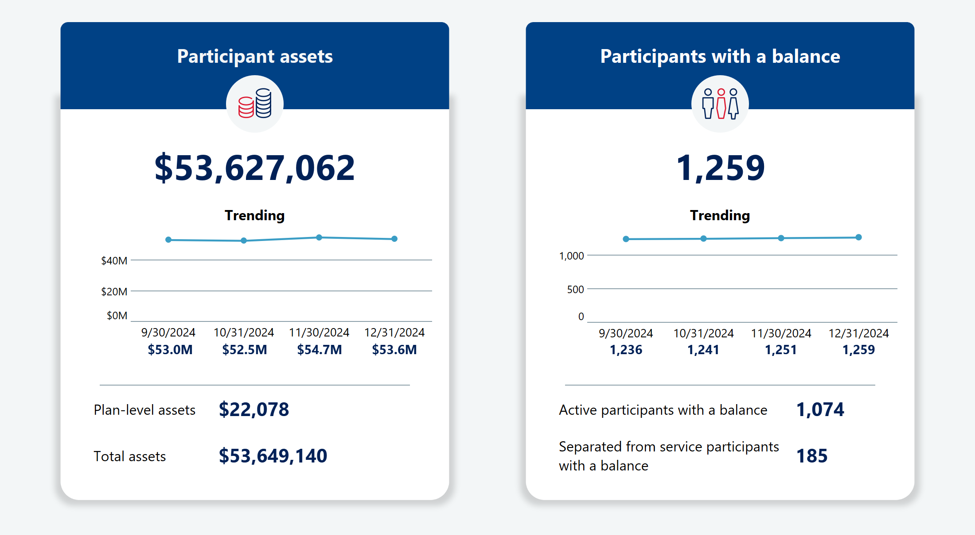
As of 12/31/2024
524867-01 Hospitality Industry 401(k) Plan

Slide 4
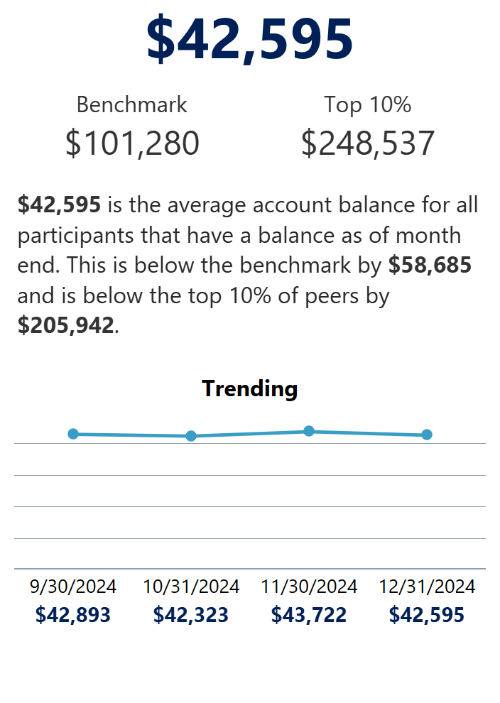
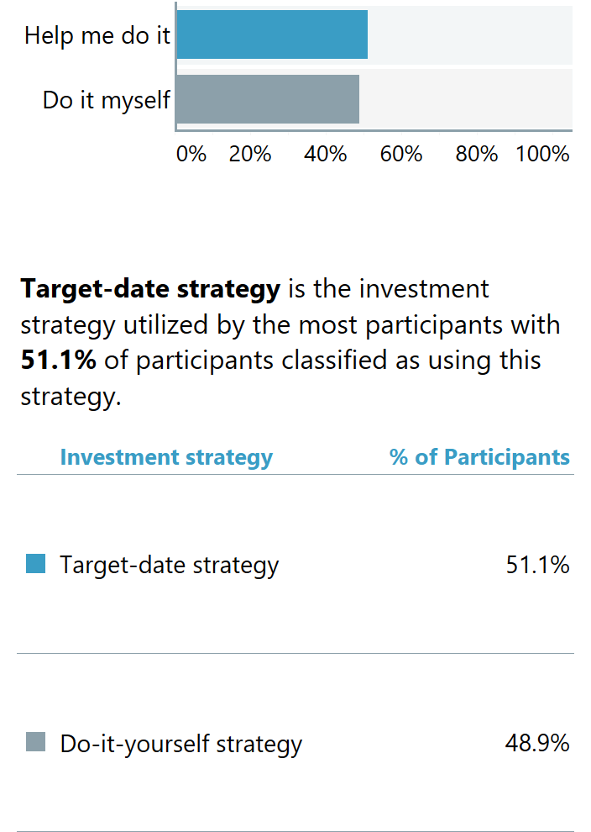
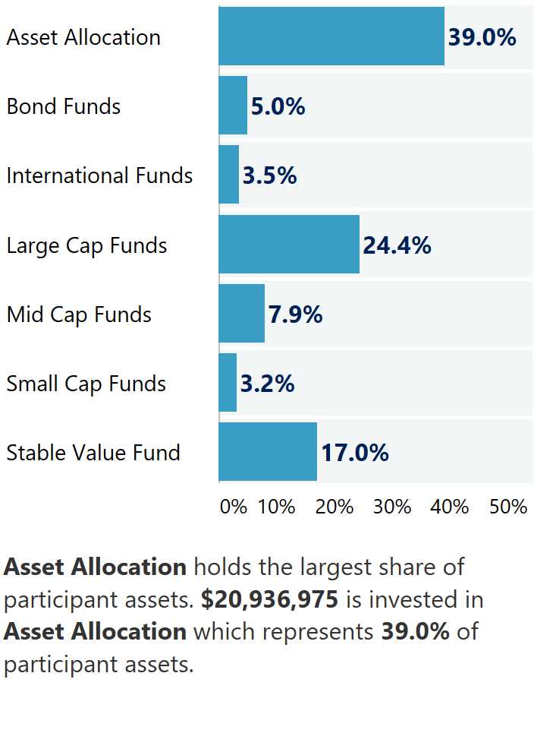
As of 12/31/2024
524867-01 Hospitality Industry 401(k) Plan

Slide 5
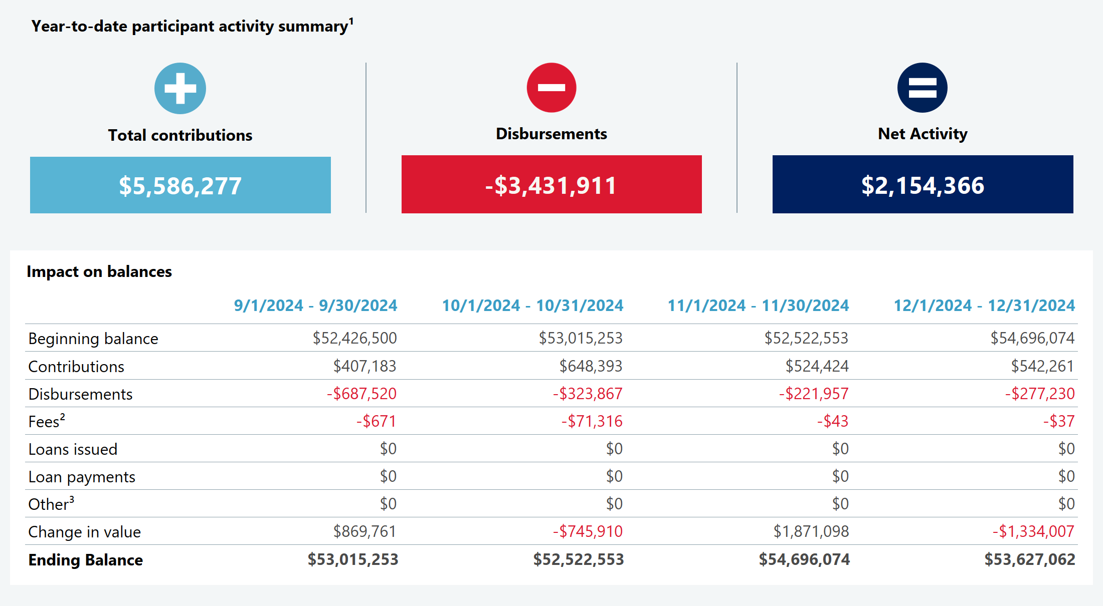
As of 12/31/2024
524867-01 Hospitality Industry 401(k) Plan

Slide 6
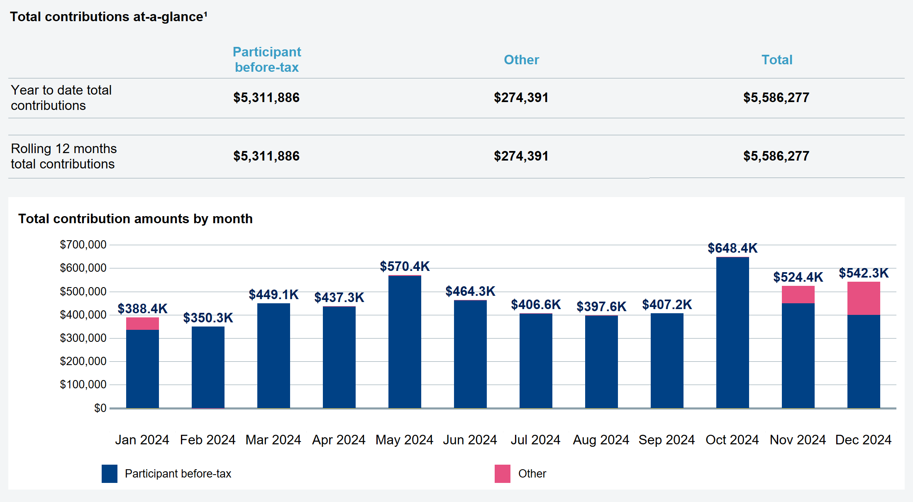
As of 12/31/2024
524867-01 Hospitality Industry 401(k) Plan

Slide 7
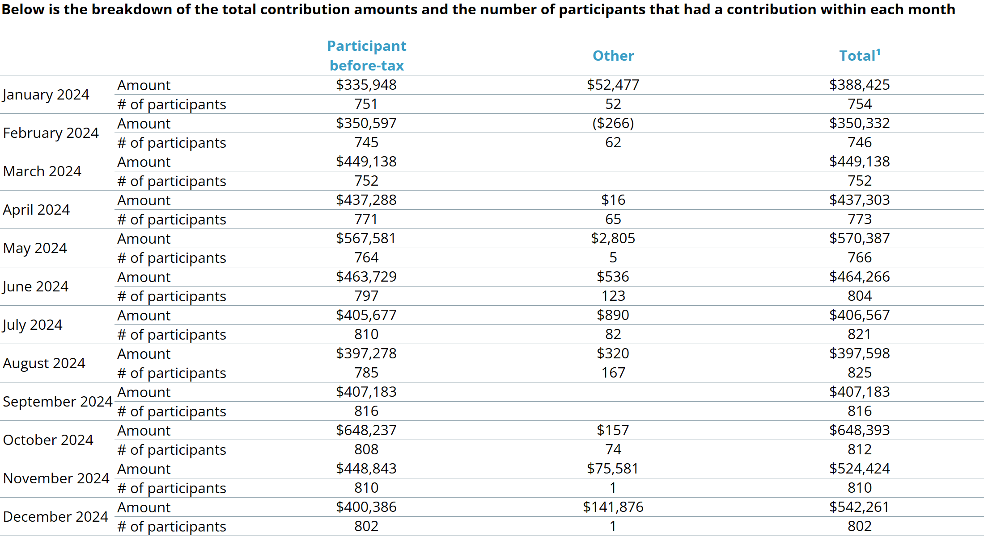
As of 12/31/2024
524867-01 Hospitality Industry 401(k) Plan

Slide 8
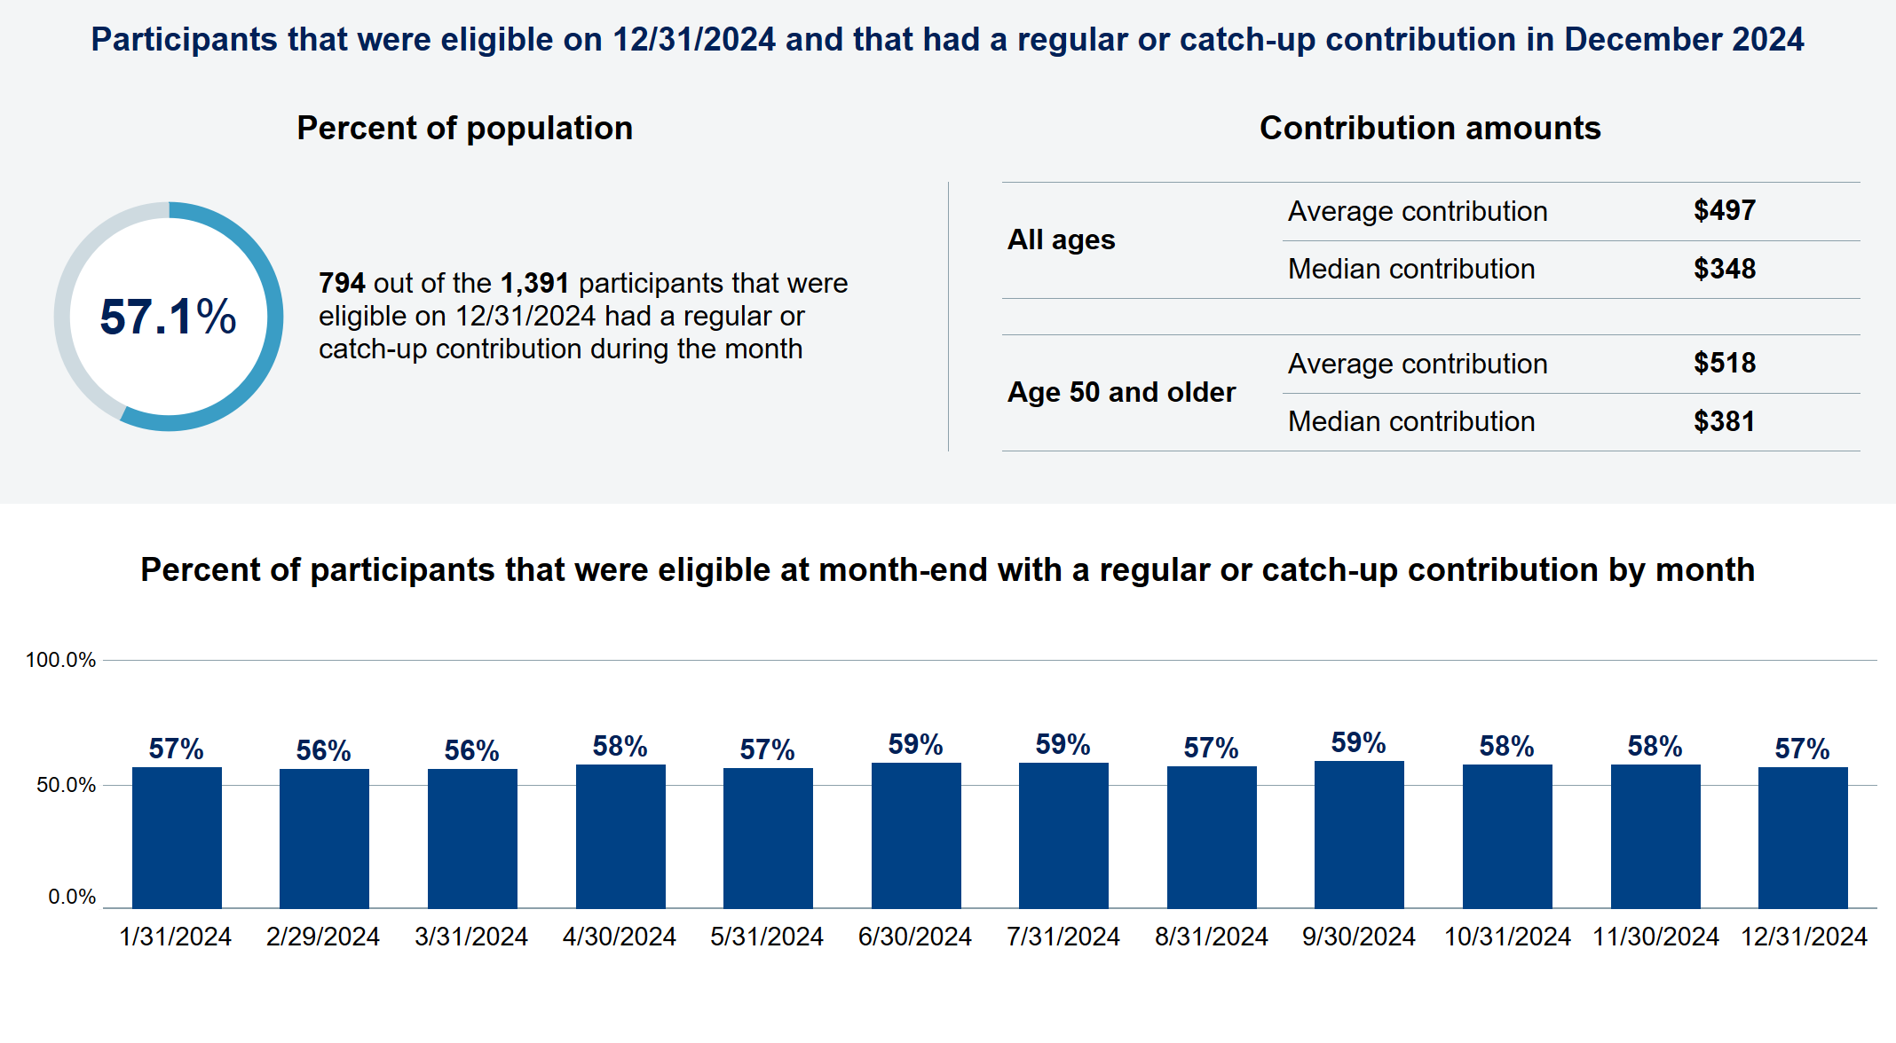
As of 12/31/2024
524867-01 Hospitality Industry 401(k) Plan

Slide 9
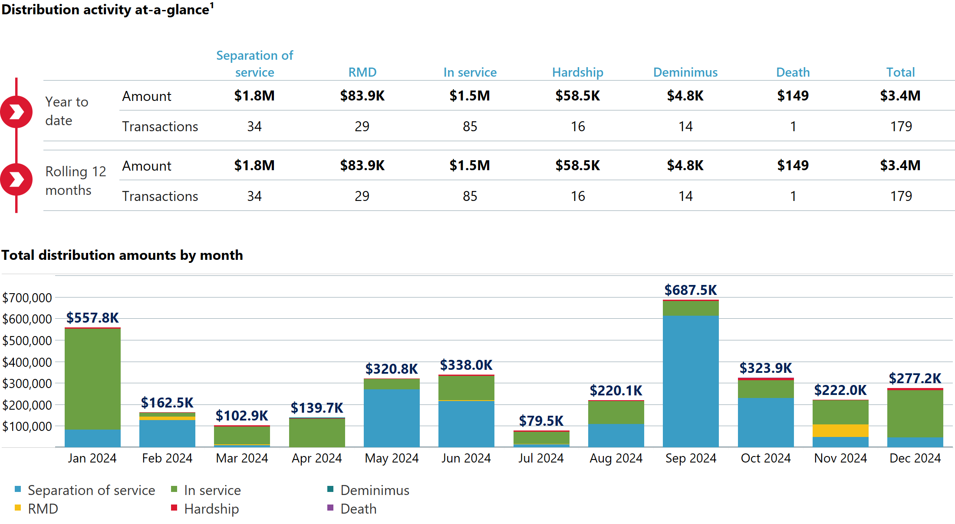
As of 12/31/2024
524867-01 Hospitality Industry 401(k) Plan

Slide 10
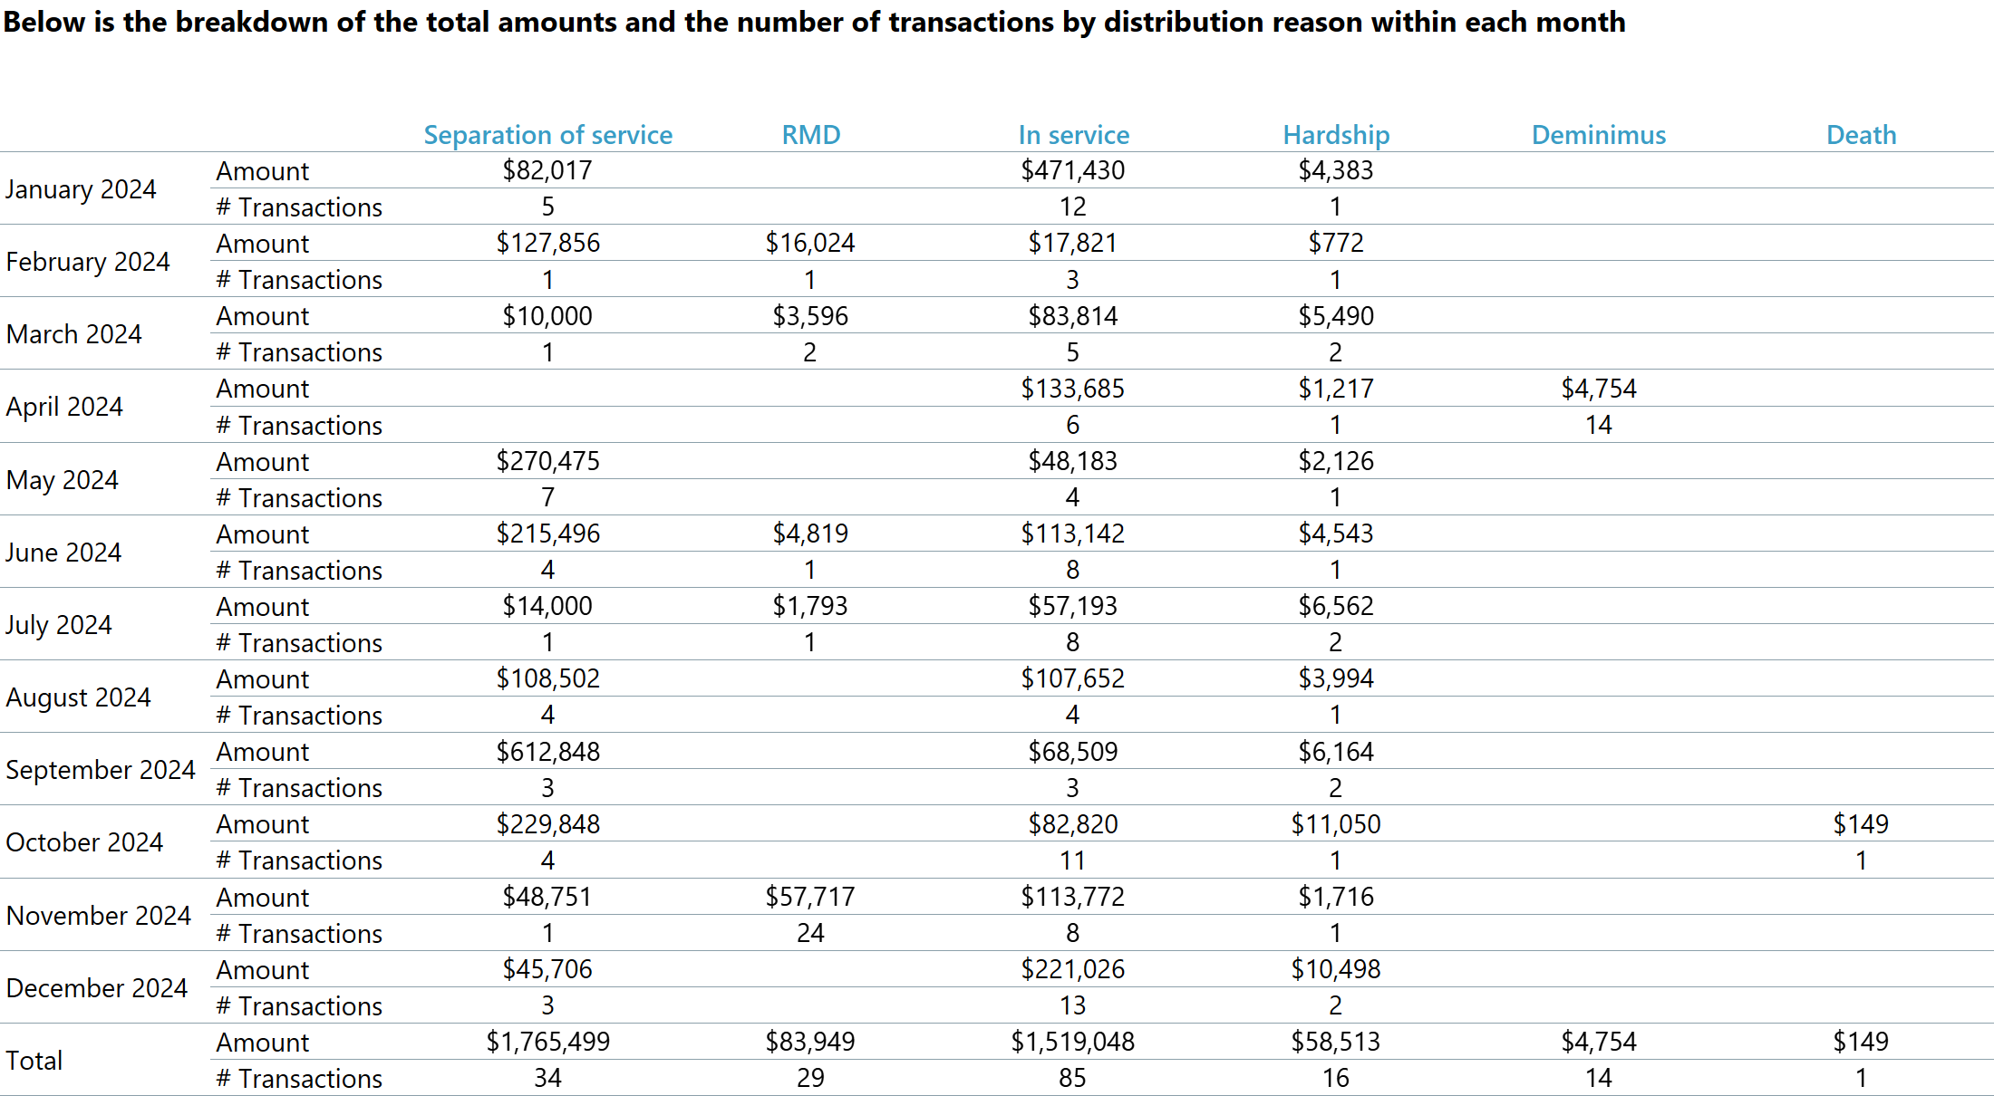
As of 12/31/2024
524867-01 Hospitality Industry 401(k) Plan

Slide 11
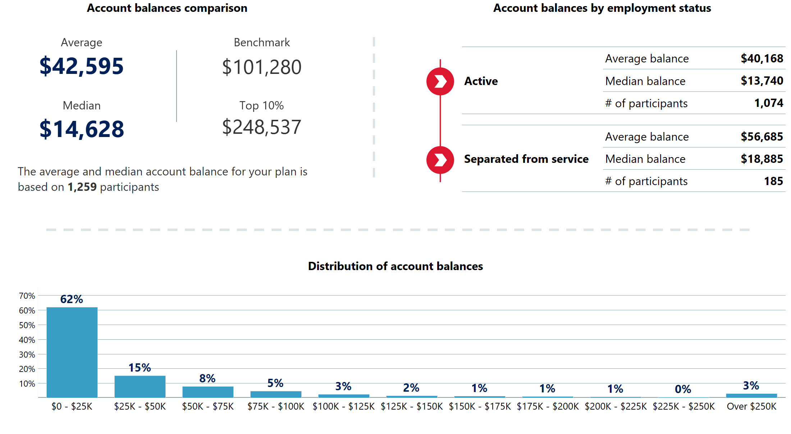
As of 12/31/2024
524867-01 Hospitality Industry 401(k) Plan

Slide 12
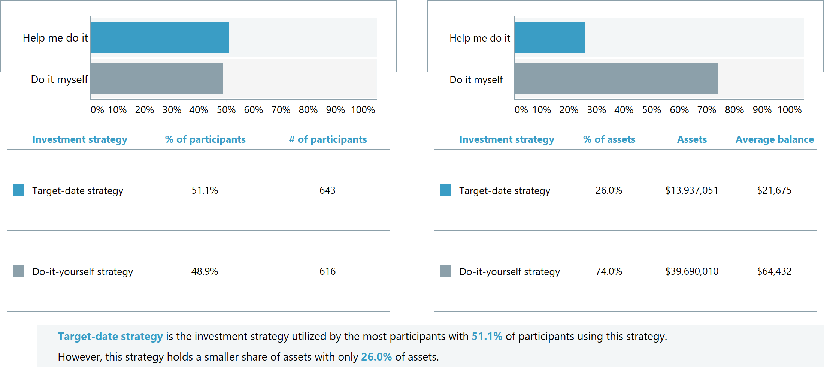
As of 12/31/2024
524867-01 Hospitality Industry 401(k) Plan

Slide 13
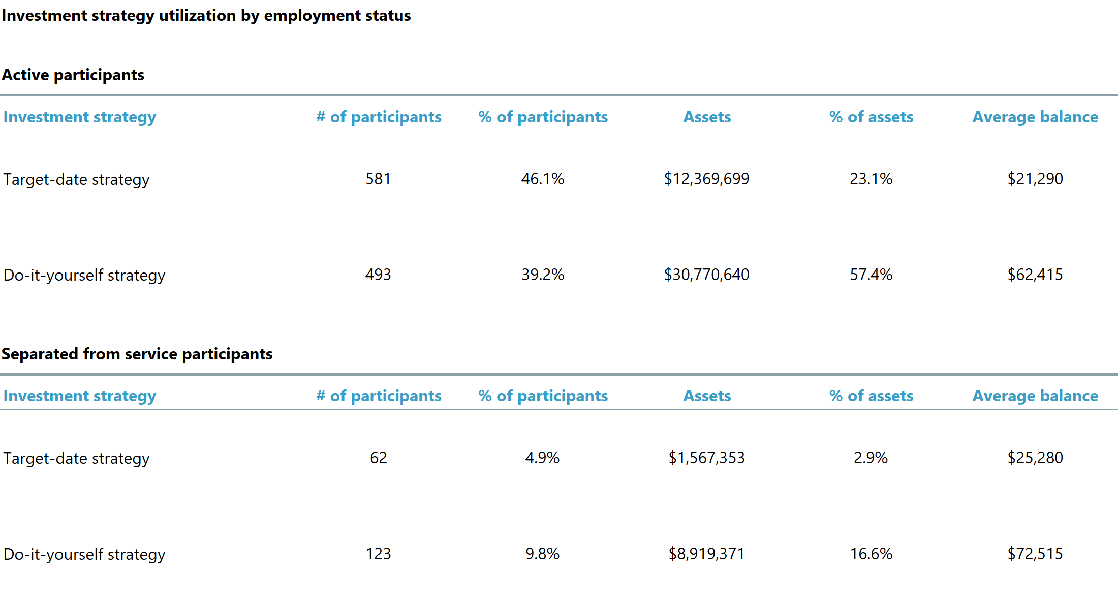
As of 12/31/2024
524867-01 Hospitality Industry 401(k) Plan

Slide 14
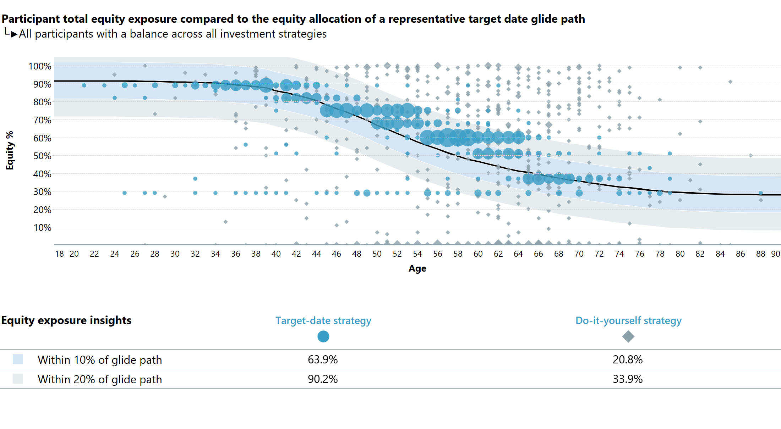
As of 12/31/2024
524867-01 Hospitality Industry 401(k) Plan

Slide 15
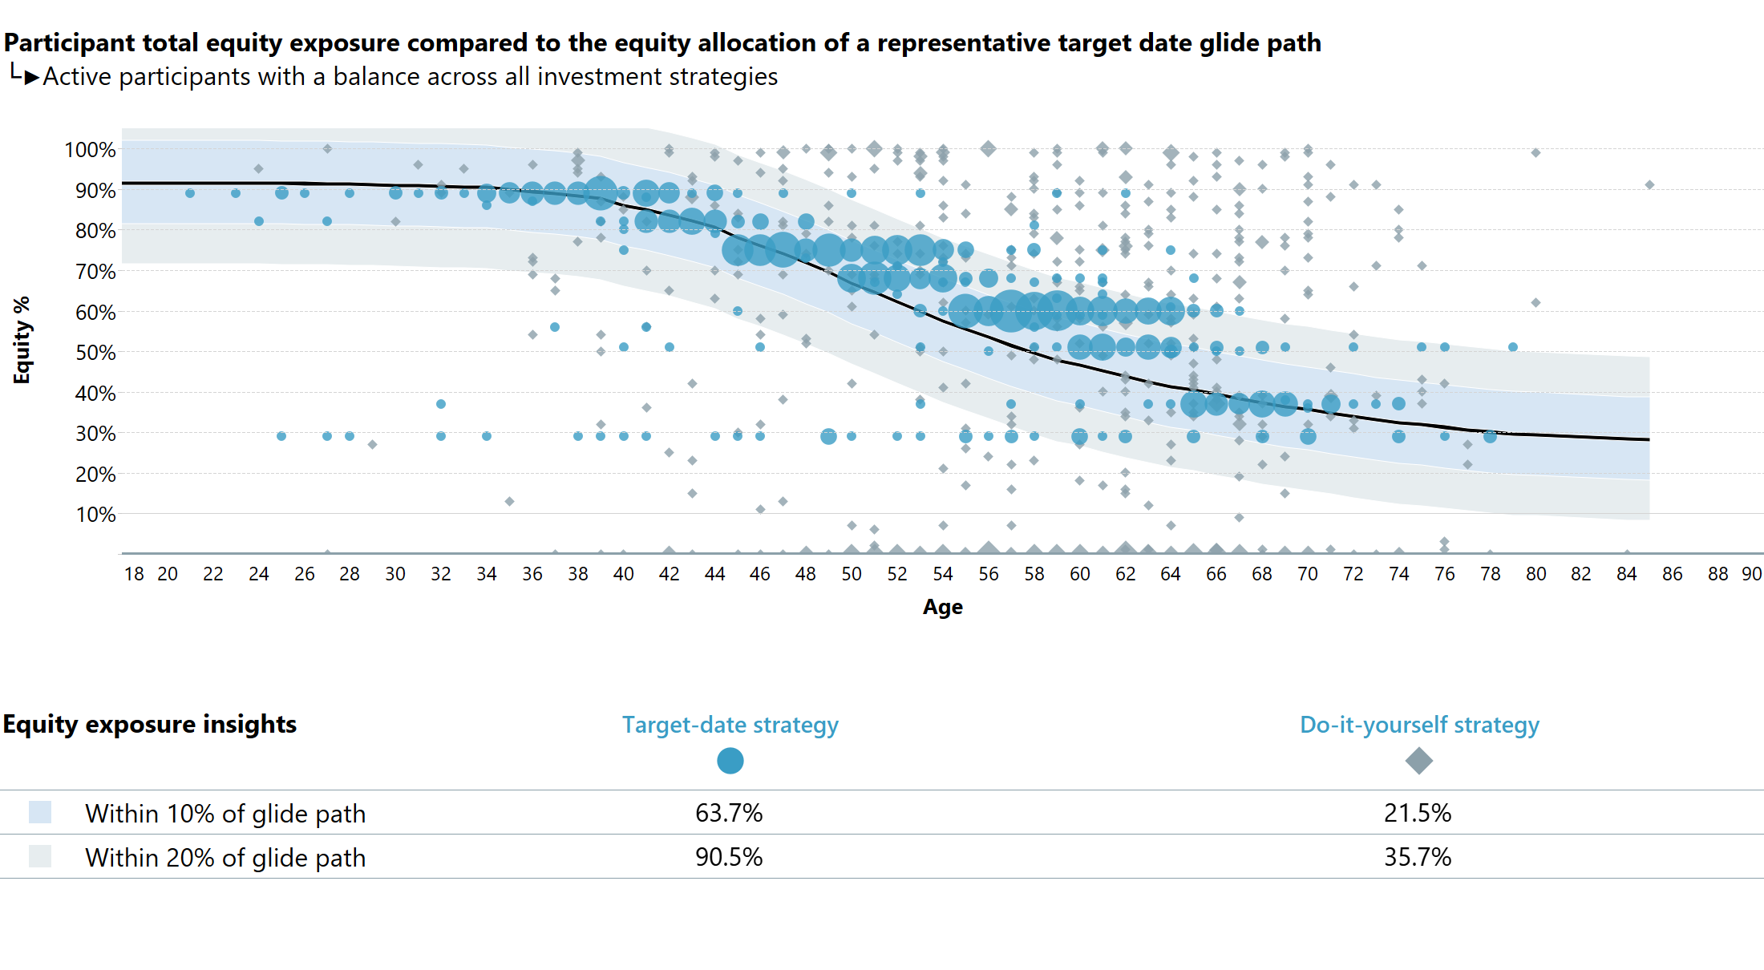
As of 12/31/2024
524867-01 Hospitality Industry 401(k) Plan

Slide 16
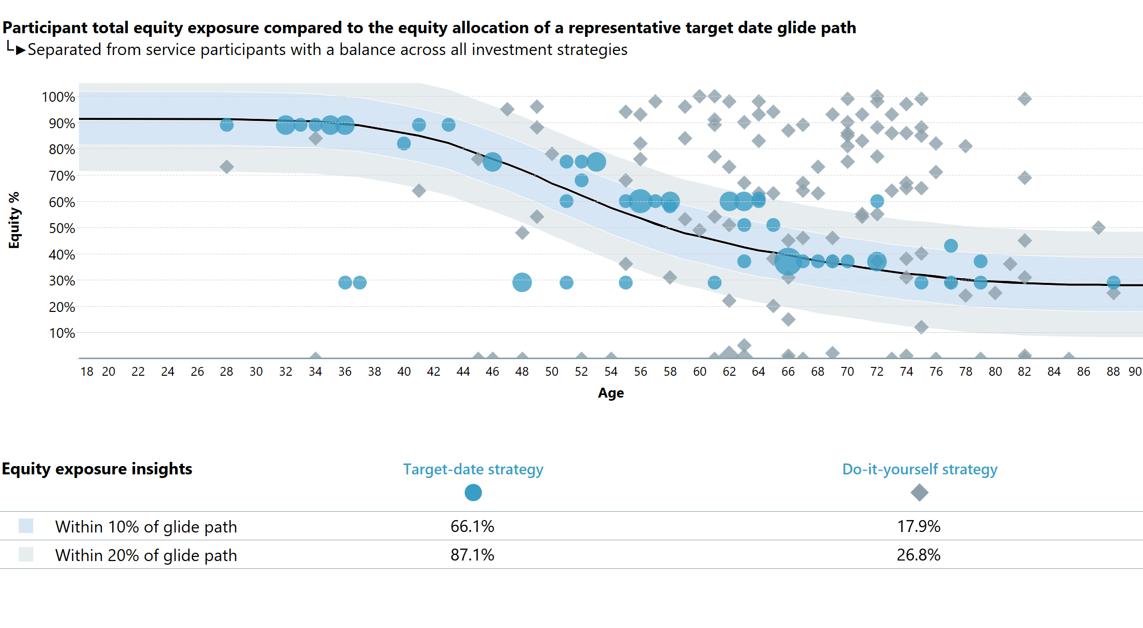
As of 12/31/2024
524867-01 Hospitality Industry 401(k) Plan

Slide 17
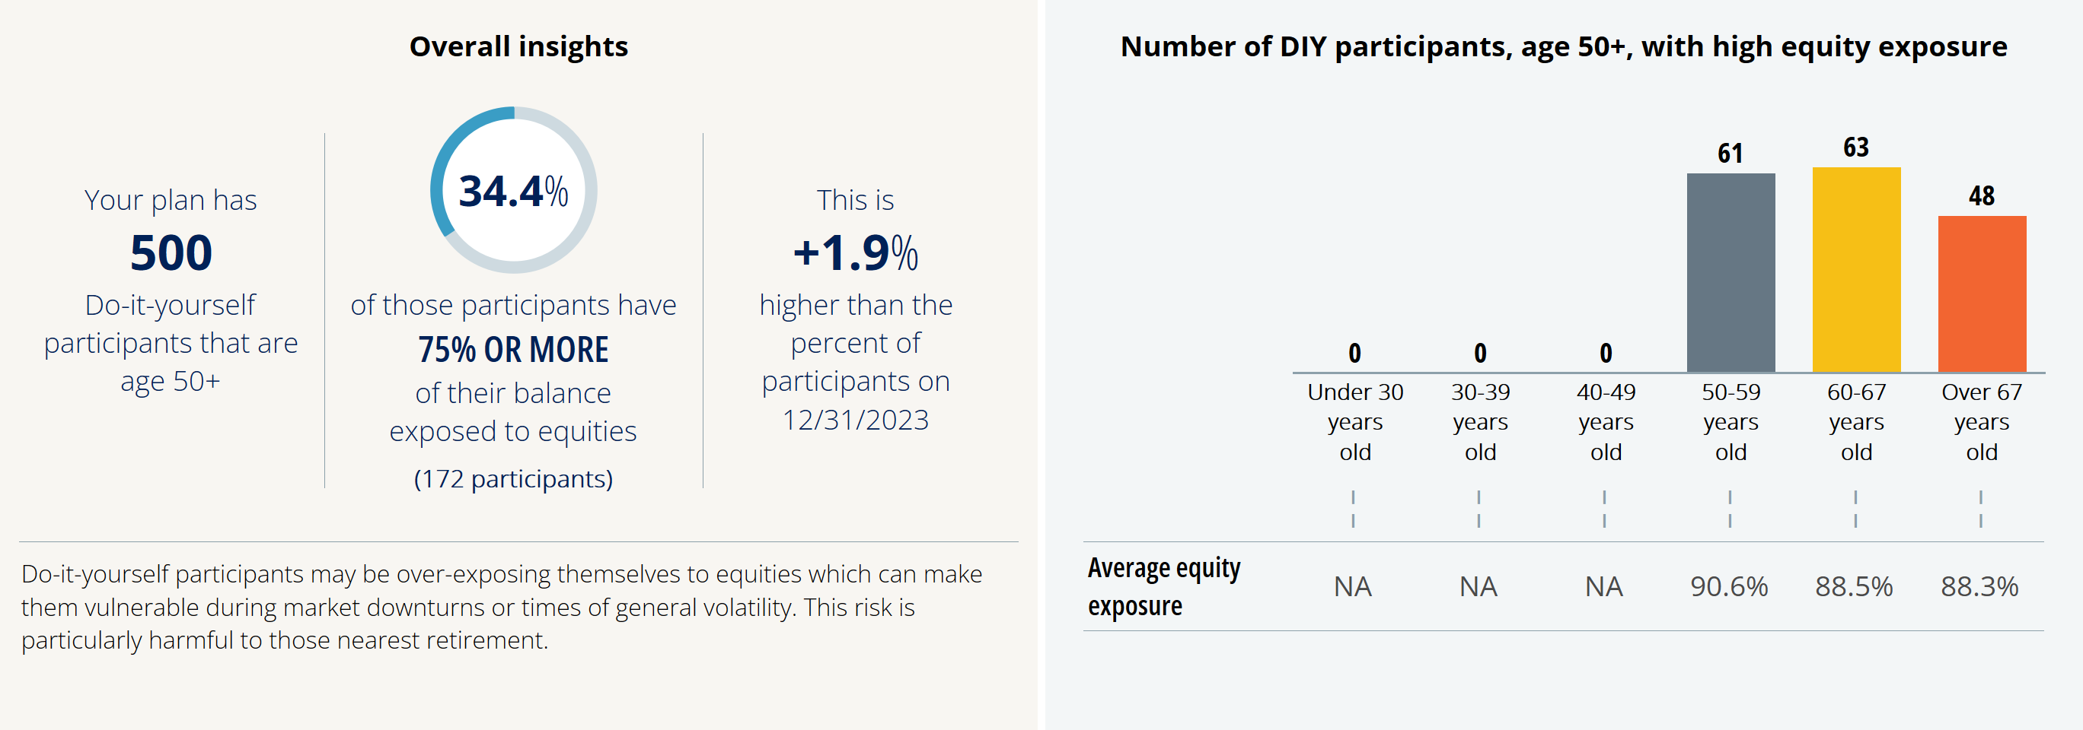
As of 12/31/2024
524867-01 Hospitality Industry 401(k) Plan

Slide 18
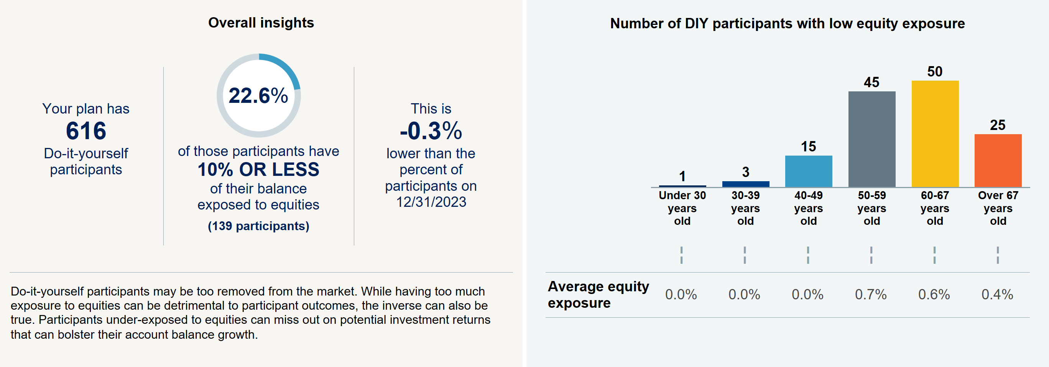
As of 12/31/2024
524867-01 Hospitality Industry 401(k) Plan

Slide 19
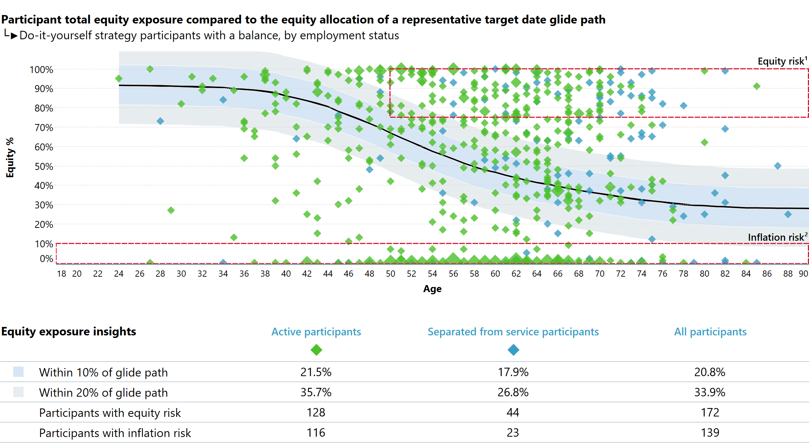
As of 12/31/2024
524867-01 Hospitality Industry 401(k) Plan

Slide 20
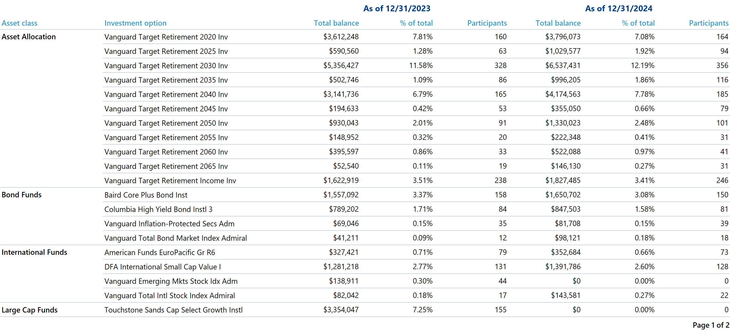
524867-01 Hospitality Industry 401(k) Plan

Slide 21
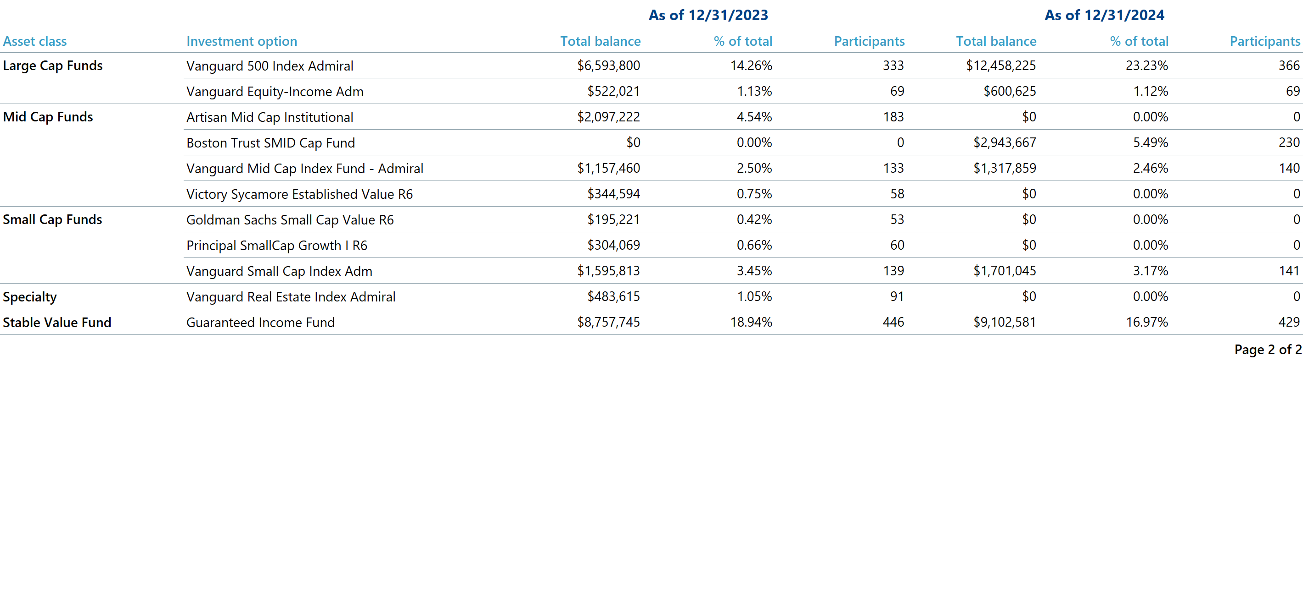
524867-01 Hospitality Industry 401(k) Plan

Slide 22
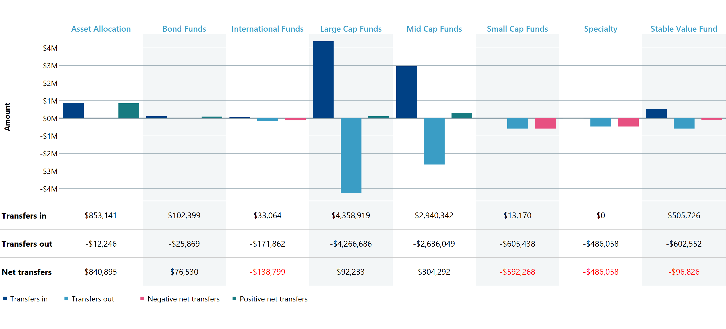
As of 12/31/2024
524867-01 Hospitality Industry 401(k) Plan

Slide 23
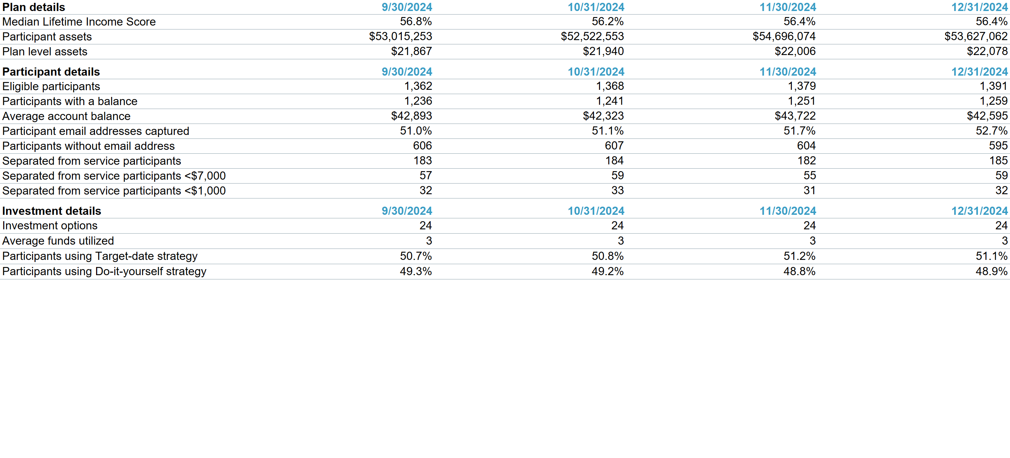
524867-01 Hospitality Industry 401(k) Plan

Slide 24
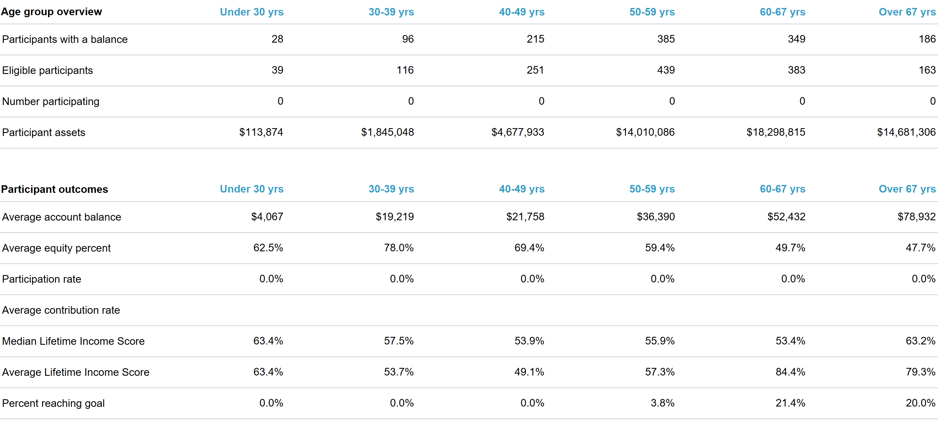
As of 12/31/2024
524867-01 Hospitality Industry 401(k) Plan

Slide 25
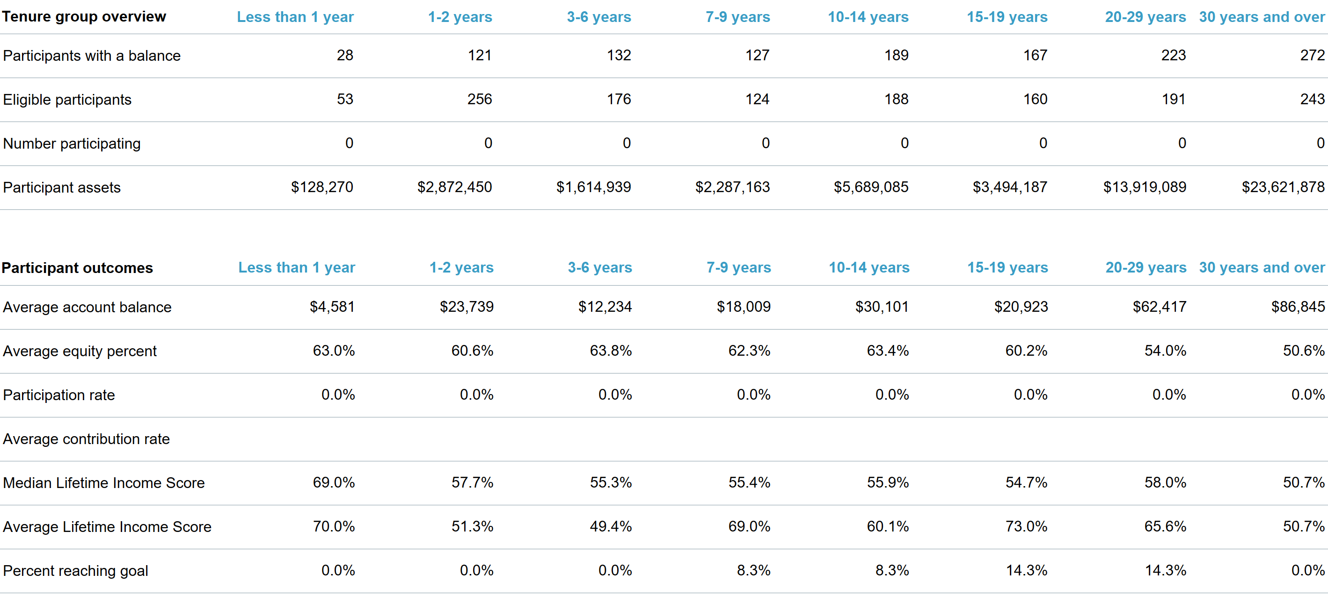
As of 12/31/2024
524867-01 Hospitality Industry 401(k) Plan

